Slide 1
Progress Presentation
Health-Wise Lifespan Assessment using IoT and AI
by
Hardik Sen
Reg No. 210907288
Under the guidance of
Internal Guide External Guide
Prof. Prashant M Prabhu Dr. Spoorthi Singh
ECE, MIT Manipal Mechatronics, MIT Manipal

Slide 2
Recap of Previous Presentation
Knowledge Base Creation: How I structured and built the dataset for generative AI.
Embedding Techniques: Methods used to convert text data into numerical representations.
Vector Database Implementation: Storing and retrieving relevant information efficiently.
RAG System Architecture

Slide 3
Contents
Introduction
LLM Selection
Prompt Engineering for Reliable Responses
LLM Configuration and Inference Process
Memory Integration for Contextual Chat
References
Next Presentation Overview

Slide 4
Introduction
LLM Integration for Health Recommendations & Q&A
We have built a healthcare domain-specific knowledge base using books, articles, and verified content.
The goal is to use this context to generate personalized health recommendations and perform question answering.
To achieve this, we are using a Retrieval-Augmented Generation (RAG) approach.
We selected the Mistral-7B-Instruct (v2) model as our LLM backend for its efficiency and instruction-following capabilities.

Slide 5
LLM Selection
We selected Mistral-7B-Instruct v2
Why Mistral-7B-Instruct?
Chosen for its lightweight architecture and cost-efficient deployment.
Fine-tuned for instruction following, making it well-suited for:
Generating health recommendations
Answering user queries naturally
Open-source model, allowing flexibility and full control over inference.
Outperforms several well-known models (like LLaMA-2 7B, Falcon 7B) in instruction-following and reasoning tasks.[1]

Slide 6
Prompt Engineering for Reliable Responses
Custom prompt templates guide the LLM's behavior and tone.
We explicitly define the LLM's role as a helpful medical assistant.
Prompt instructs the model to:
Use only the retrieved context to answer.
Avoid guessing or fabricating information.
Reject non-medical or irrelevant queries.
Personalized recommendation prompts are dynamically generated using user health and lifestyle data.
Ensures outputs are factual, safe, and context-aware.

Slide 7
LLM Configuration and Inference Process
Using Mistral-7B-Instruct v0.3 via Hugging Face Inference API.
Key parameters configured:
temperature = 0.5: balances creativity with stability
max_tokens = 512: controls length of response
Inference involves:
User input converted to a question prompt
Relevant context retrieved from Pinecone vector DB
Prompt + context passed to the LLM for generation
Response returned and stored in memory for continuity
Model role defined as medical assistant to ensure domain focus

Slide 8
Memory Integration for Contextual Chat
Implemented ConversationBufferMemory to retain chat history.
Memory stores both user messages and LLM responses.
Enables:
Context-aware follow-up questions
Smooth, ongoing dialogue without repeating information
Referencing prior recommendations during chat
Memory is updated after each interaction using add_user_message() and add_ai_message() methods.

Slide 9
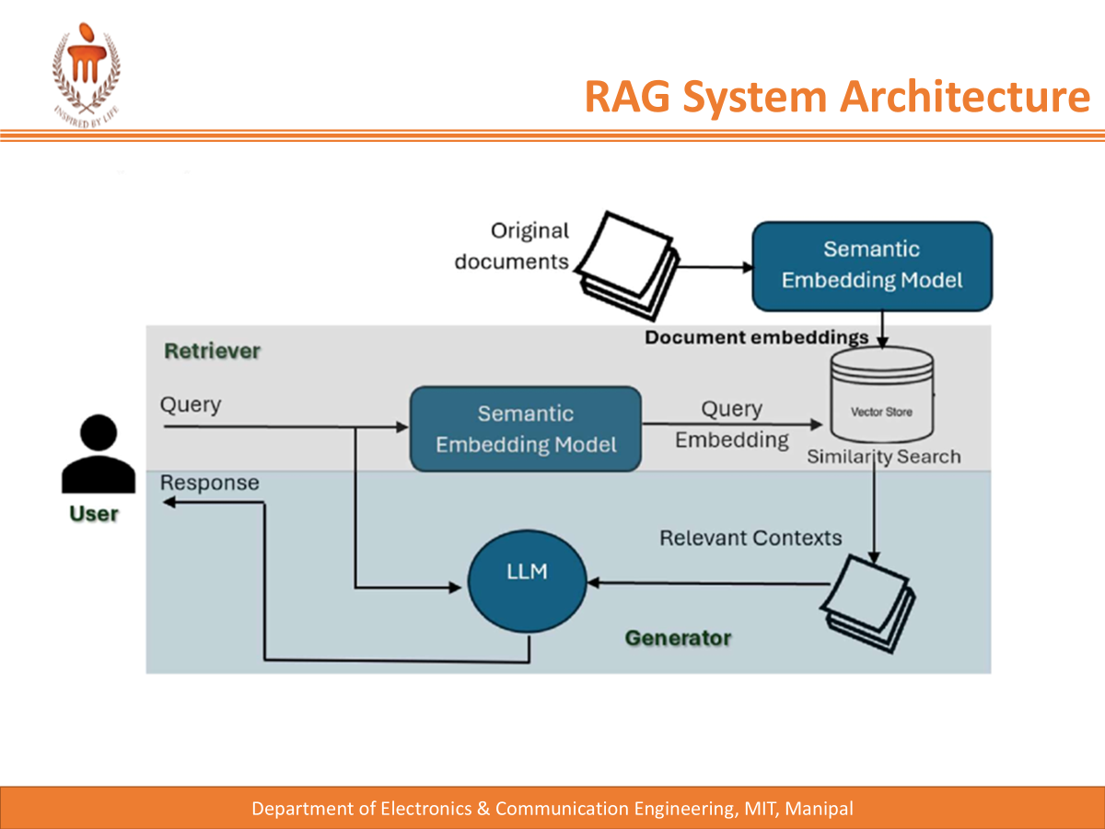

Slide 10
References
[1] Mistral AI. (2023). Announcing Mistral 7B. Retrieved from https://mistral.ai/news/announcing-mistral-7b
[2] Pinecone. (n.d.). The Vector Database for AI. Retrieved from https://www.pinecone.io
[3] LangChain. (n.d.). Building LLM Applications with LangChain. Retrieved from https://www.langchain.com
[4] Hugging Face. (n.d.). Transformers & Inference Endpoints. Retrieved from https://huggingface.co
[5] Liu, P., Yuan, W., Fu, J., Jiang, Z., Hayashi, H., & Neubig, G. (2021). Pre-train Prompt Tune: Exploring the Landscape of Prompt Engineering. arXiv preprint arXiv:2107.13586. Retrieved from https://arxiv.org/abs/2107.13586
[6] LangChain. (n.d.). ConversationBufferMemory – Memory for Conversational Chains. Retrieved from https://docs.langchain.com/docs/components/memory

Slide 11
Next Presentation Overview
Web Application Development:
Designing a complete web interface with:
Home page
User form to collect health and lifestyle inputs
Life expectancy prediction display
Integrated chatbot window for recommendations and Q&A
Backend Integration:
Connecting frontend to backend using FastAPI
Serving:
ML model predictions
LLM-based personalized recommendations
Real-time chat with memory and context

Slide 12
Thank You

